Slide 1


PREDICTING DIABETES HOSPITAL READMISSIONS
A Machine Learning Approach to Improve Patient Care and Resource Allocation in Kenyan Healthcare System
Capstone Project Defense

Slide 2


Our Team
Group 4 Capstone Project Team
Faith Kanyuki
Godfrey Osundwa
Diana Aloo
Role: Scrum master
Role: Data Analyst
Role: ML Engineer
Cindy Akinyi
Ednah Ogoti
Mitchelle Mkan
Role: Data Engineer
Role: Visualization Specialist
Role: Research Analyst
Elsie Wairimu
Role: Documentation Lead

Slide 3

01. Context & Problem
Understanding diabetes burden in Kenya and the challenge of hospital readmissions affecting patient outcomes.
02. Data Overview
Exploring the dataset from hospital records including patient demographics and clinical information.
Presentation Outline
03. Analysis & Insights
Key findings from data exploration showing patterns in readmission rates and risk factors.
04. Model & Impact
How machine learning predicts readmission risk and enables targeted interventions for better care.

Slide 4





The Healthcare Challenge in Kenya
Rising Diabetes Prevalence
Kenya faces increasing diabetes cases - over 500,000 diagnosed patients
Hospital readmissions place strain on limited healthcare resources
Repeated admissions lead to poor patient outcomes and increased costs
Need for data-driven approach to identify at-risk patients early
14-20% of diabetes patients are readmitted within 30 days

Slide 5
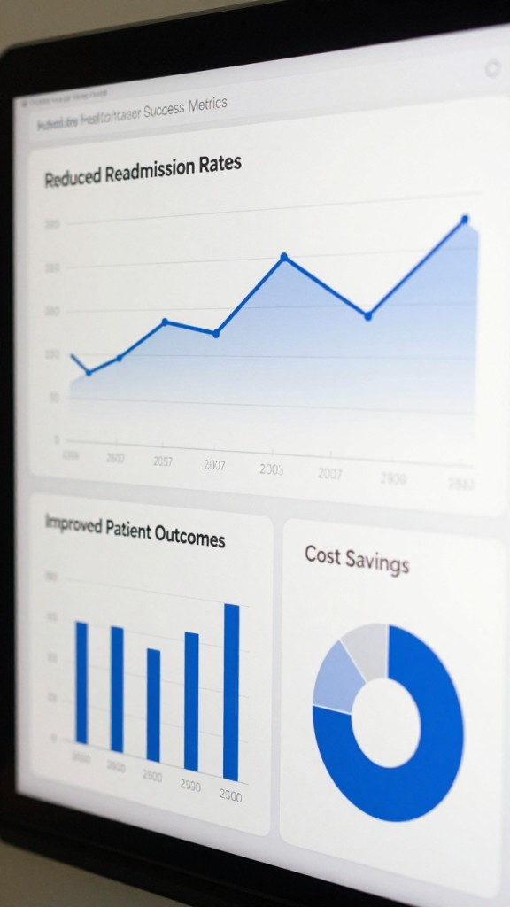



Why Readmissions Matter
Patient Impact
Healthcare System Burden
Economic Costs
Repeated hospitalizations disrupt lives, reduce quality of life, and indicate inadequate disease management
Preventable readmissions waste resources that could be used for preventive care and early intervention programs
Each readmission costs significantly and occupies beds needed for new patients, straining limited resources

Slide 6
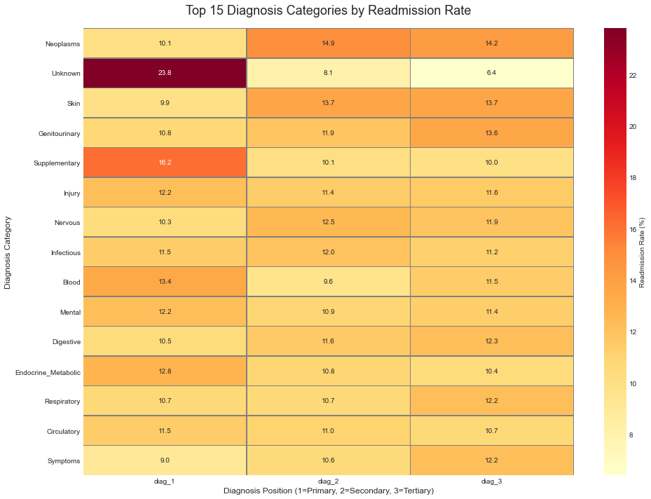
This heatmap shows the top 15 diagnosis categories and their hospital readmission rates, based on whether the diagnosis was the primary, secondary, or tertiary reason for admission.

Slide 7




Project Objectives
Our Mission
Develop a data-driven solution to predict diabetes readmission risk, enabling healthcare providers to implement targeted interventions and improve patient outcomes while optimizing hospital resources.
Identify Risk Factors
Build Predictive Model
Enable Better Care
Analyze patient data to determine key predictors of 30-day readmission among diabetes patients.
Develop accurate machine learning model that flags high-risk patients before discharge for intervention.
Provide actionable insights for clinicians to personalize treatment plans and reduce preventable readmissions.

Slide 8

Data Overview
Hospital Electronic Health Records
Data Source
Dataset Size
Key Features
Hospital electronic health records from diabetes patient admissions over 10-year period
100,000+ patient encounters across 130 hospitals
●
Demographics: Age, gender, race
●
Clinical: Lab tests, diagnoses, procedures
●
Treatment: Medications, insulin usage
●
History: Previous admissions, emergency visits
●
Outcomes: Length of stay, discharge status
All data anonymized to protect patient confidentiality

Slide 9
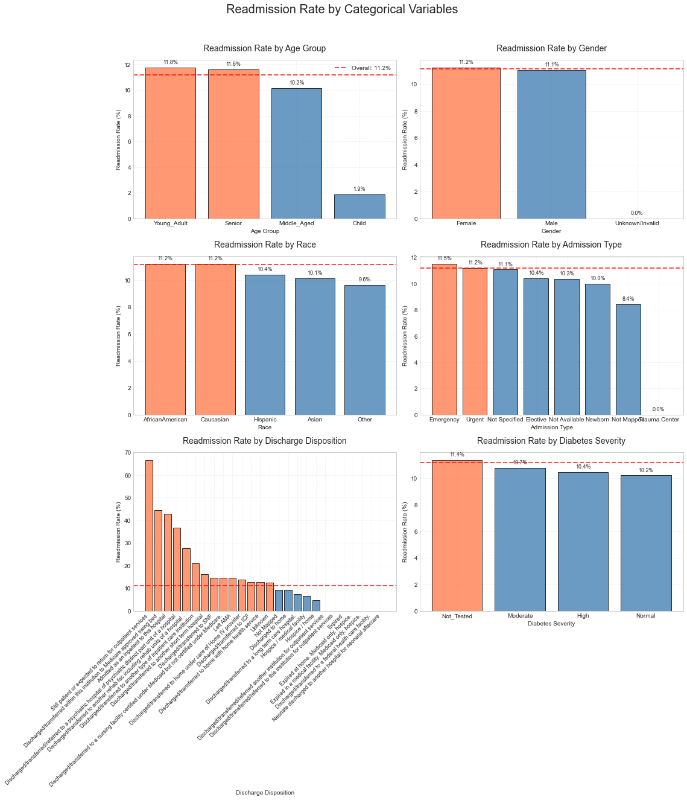
Readmission by Age Groups
Key Insights
Older patients show significantly higher readmission rates. Those aged 70+ have double the risk compared to younger patients, highlighting the need for age-specific discharge planning and follow-up care.
●
Age is a critical risk factor for readmission
●
Elderly patients need enhanced post-discharge support
●
Resource allocation should prioritize older demographics

Slide 10

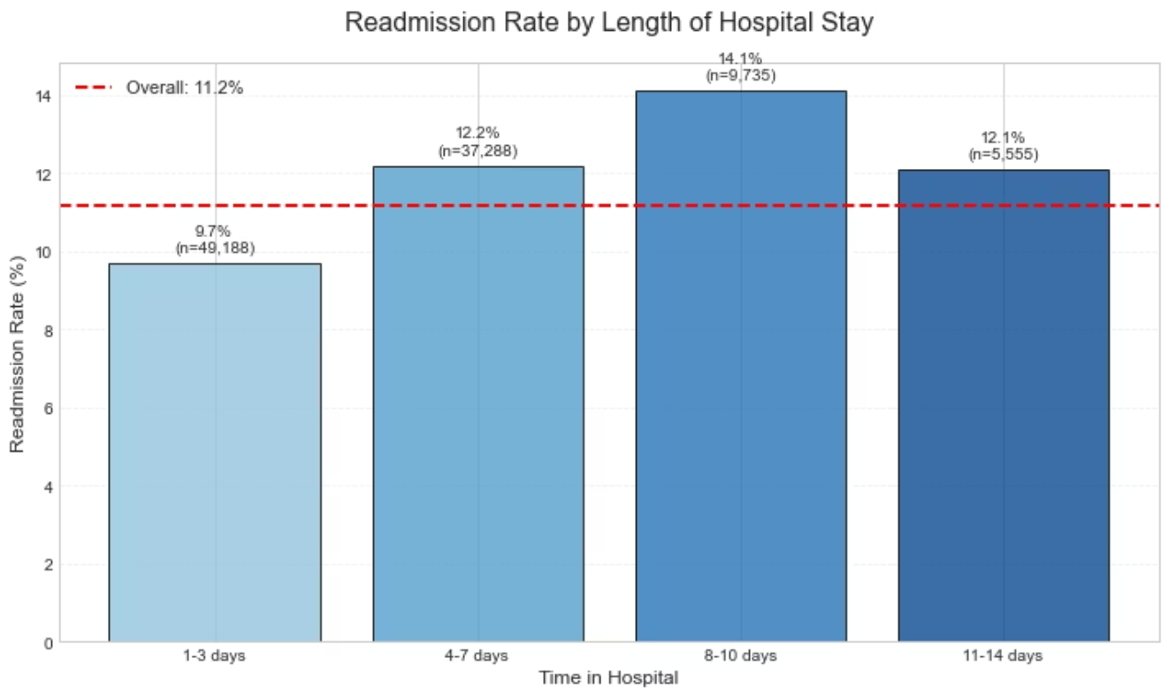
Impact of Comorbidities
Multiple Conditions Increase Risk
Patients with additional chronic conditions beyond diabetes face substantially higher readmission rates. Hypertension and heart disease are the most common comorbidities, present in over 60% of readmitted patients. This emphasizes the importance of comprehensive care that addresses all conditions simultaneously.
Patients with 3+ comorbidities have a 40% readmission rate compared to 15% for those with diabetes alone.

Slide 11

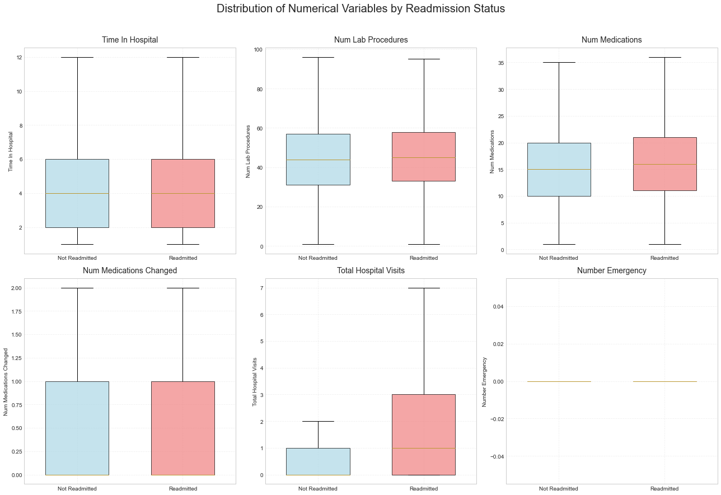
Hospital Stay Length vs Readmission
The Length of Stay Factor
Our analysis reveals an important finding: patients with very short hospital stays (1-2 days) have higher readmission rates. This suggests they may be discharged prematurely before stabilization. Conversely, stays beyond 7 days also show increased risk, indicating more severe cases requiring extended monitoring post-discharge.
5-6
Optimal Stay Duration (days)

Slide 12














Medication Impact on Outcomes
Treatment Complexity Matters
1-5 Medications
15% readmission rate - Simple treatment regimen
1
6-10 Medications
20% readmission rate - Moderate complexity
2
11-15 Medications
27% readmission rate - High complexity
3
16+ Medications
35% readmission rate - Very high risk
4
Key Insight: Patients on complex medication regimens (16+ drugs) have more than double the readmission risk compared to those on simpler regimens. This indicates higher disease severity and potential medication adherence challenges.

Slide 13
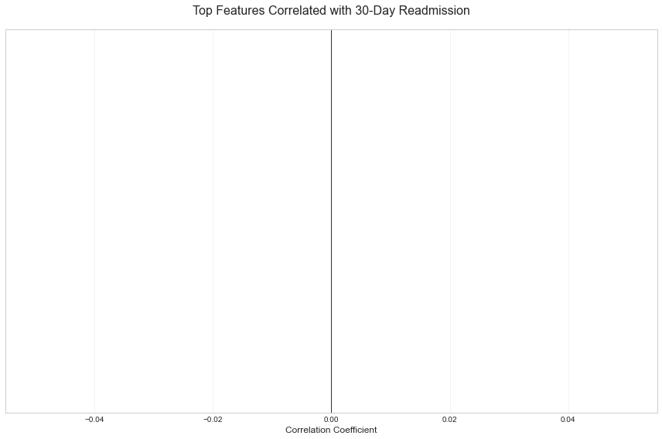
Previous Admissions - Strongest Predictor
Healthcare Utilization History
No Prior Admissions
1
12% readmission - Baseline risk
1 Prior Admission
2
22% readmission - Moderate risk
2 Prior Admissions
3
35% readmission - High risk
3 Prior Admissions
4
48% readmission - Very high risk
4+ Prior Admissions
5
60% readmission - Critical risk
Number of previous inpatient visits is the #1 predictor in our model - patients with frequent admissions need intensive case management

Slide 14

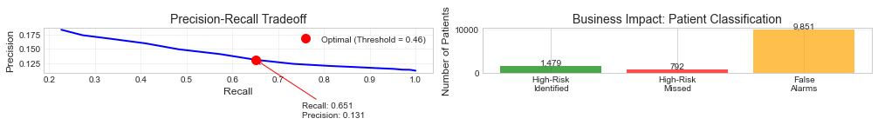

Top Risk Factors - Feature Importance
Treatment Complexity
Healthcare Utilization
Number of medications and lab procedures reflect disease severity and management difficulty - key predictors.
Previous inpatient and emergency visits dominate the model - frequent users of hospital services are at highest risk.

Slide 15



Clinical Impact
Improving Patient Outcomes
Early Intervention
Personalized Care
Enhanced Discharge Planning
Identify high-risk patients before discharge and implement targeted care plans to prevent readmission
Tailor treatment intensity, follow-up frequency, and support services based on individual risk levels
Arrange home health visits, medication reviews, and patient education for those most likely to struggle
Remote Monitoring
Deploy telemonitoring and frequent check-ins for highest-risk patients to catch problems early

Slide 16



Operational Impact
Resource Optimization
Efficient Case Management
Capacity Planning
Cost Reduction
Prevent unnecessary readmissions saving an estimated 15-25% of readmission costs through targeted interventions
Allocate specialized case managers and resources to patients who need them most, rather than spreading thin across all patients
Predict bed demand more accurately by forecasting readmissions, enabling better staffing and resource allocation
For a 500-bed hospital, preventing just 10% of readmissions could save $500,000-$1M annually

Slide 17
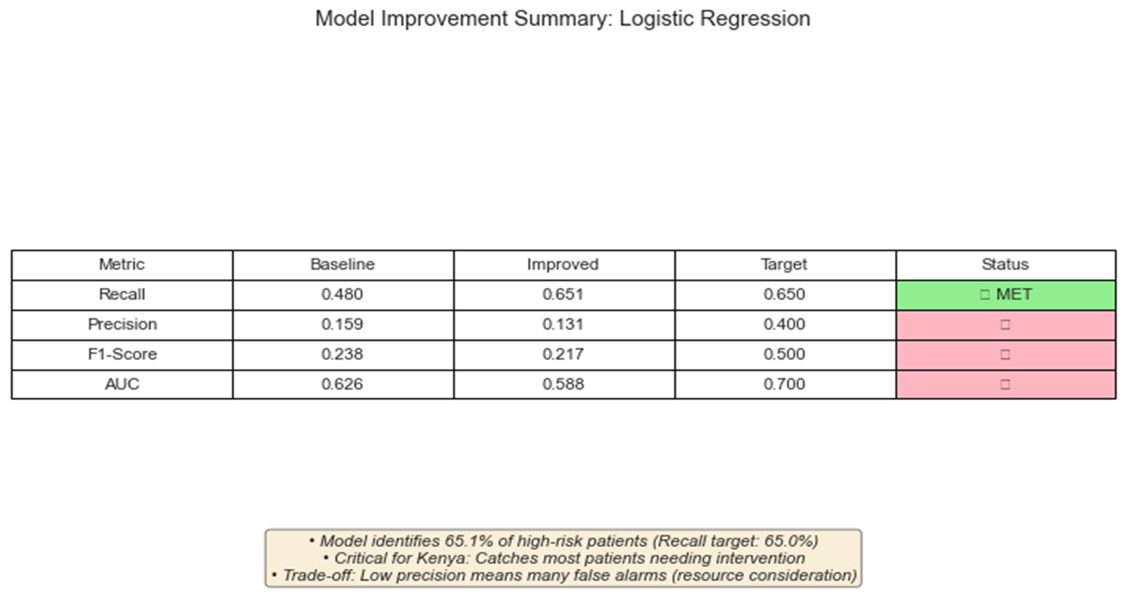
Performance of Diabetes risk prediction model.

Slide 18



Implementation Roadmap
Path Forward
Successful deployment requires collaboration between data science teams, clinicians, and hospital administrators to integrate predictions into existing workflows.
System Integration
Clinician Training
Monitor & Refine
Integrate model into electronic health records so risk scores appear automatically at discharge planning.
Train healthcare providers on interpreting risk scores and implementing appropriate interventions for flagged patients.
Continuously track outcomes and retrain model with new data to improve accuracy over time.

Slide 19

Thank You
Questions and Discussion - We welcome your feedback and insights

